Slide 1


Slide 2
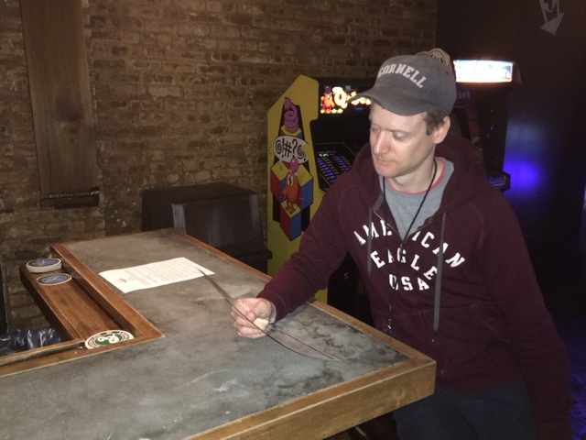
PROBLEM // BEER SELECTION IS TEDIOUS

Slide 3
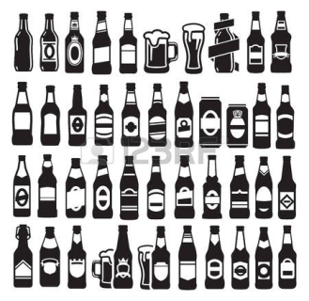




PROBLEM // BEER SELECTION IS TEDIOUS
WIDE VARIETY OF BEER IS NEGATIVELY IMPACTING CUSTOMERS’ SELECTION PROCESS
A large proportion of customers have difficulty selecting a beer at a bar
Leading to unsatisfactory beer selections, increased order times & missed sales opportunities
… as a result, bars are looking to enhance the customer experience & grow sales
Source: customer research
IMPROVING THE CURRENT SELECTION PROCESS AND CREATING LONG-TERM VALUE CAN BE REALIZED BY… CURATING BEER RECOMMENDATIONS & CONTINUOUSLY IMPROVING ANALYTICS & PERFORMANCE

Slide 4








SOLUTION // CURATED, REAL-TIME BEER SELECTION
Swiil will enable bars / customers to simplify the beer selection process, improve ordering efficiency, and increase sales
External Data Sources
Data
Point of Sale
KEY FEATURES
Insight & Knowledge
Curated Beer Recommendations: provide data-driven recommendations for beer selection in order to enhance the customer experience and improve / optimize bar sales
Food-Beer Pairings: enables bars/customers to make more dynamic ordering decisions, resulting in increased sales for bars
Bar Performance Management: app will provide clear metrics (knowledge and insights) of bar performance, that allows bars to leverage data to make critical operational and business decisions

Slide 5
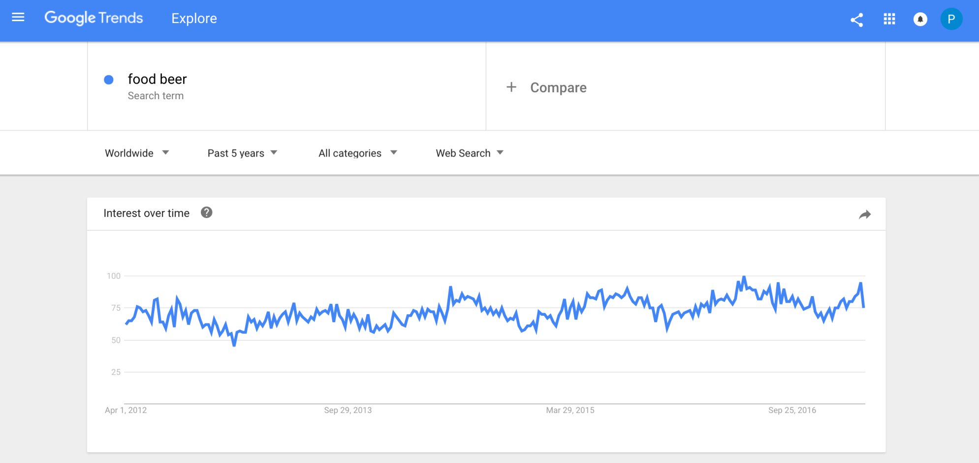
MARKET // GROWING INTEREST IN FOOD-BEER PAIRINGS
Over the last 4 years, interest in food-beer pairings has increased by ~10 basis points
Swiil is well positioned to capture this trend
Source: google trends

Slide 6
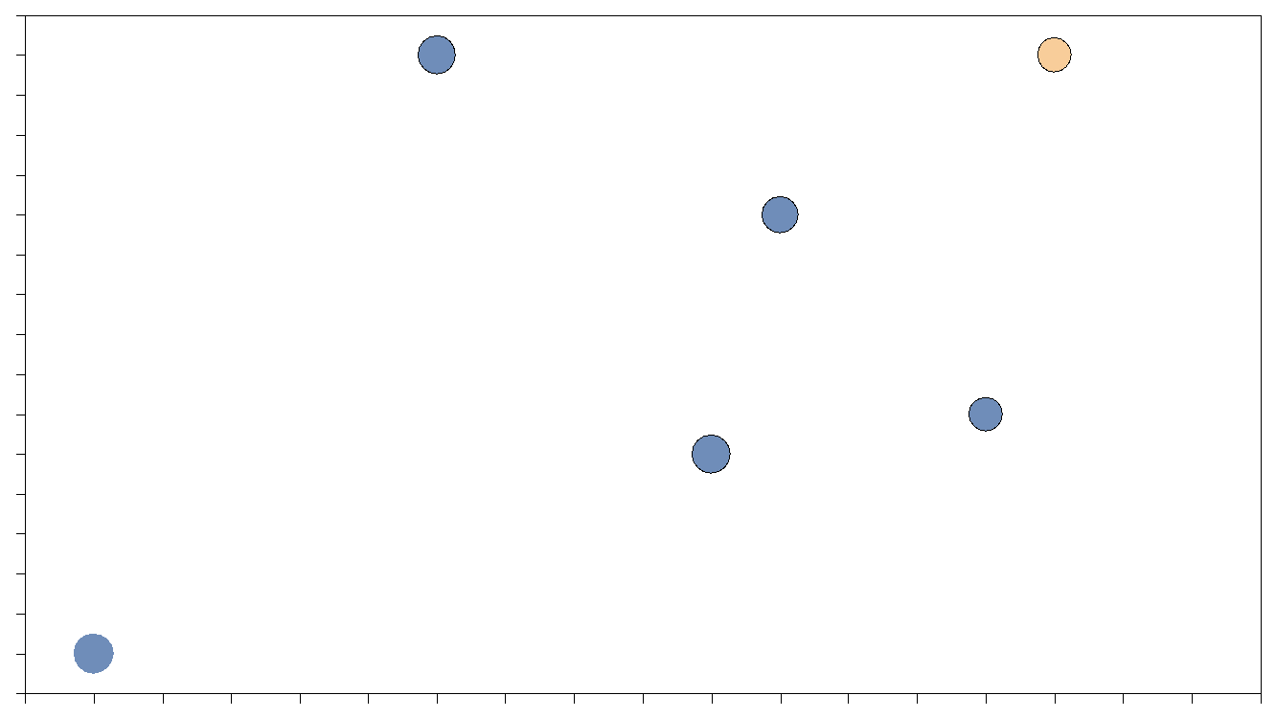





COMPETITIVE LANDSCAPE //
Swiil uses data analytics to provide a dynamic user experience
Personally Dynamic Experience
Locally Responsive Environment

Slide 7
DEMO //
https://projects.invisionapp.com/share/TCB0TOI9A#/screens

Slide 8
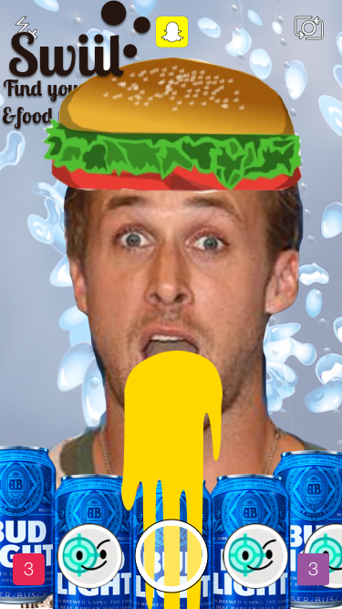
THANK YOU //
#SwiilIsSwoll

